Slide 1
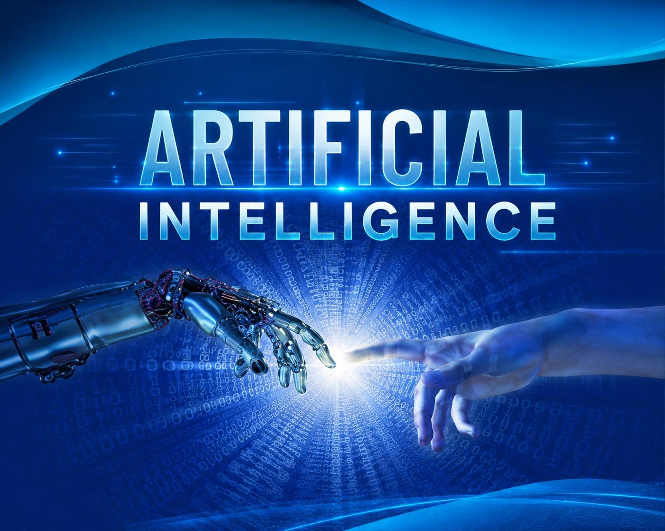
ARTIFICIAL INTELLIGENCE IN DAILY LIFE

Slide 2
Introduction
Artificial Intelligence (AI) is a technology that enables machines and applications to learn, think, and make smart decisions like humans. AI is used in many daily applications such as YouTube, Google Maps, and voice assistants.

Slide 3
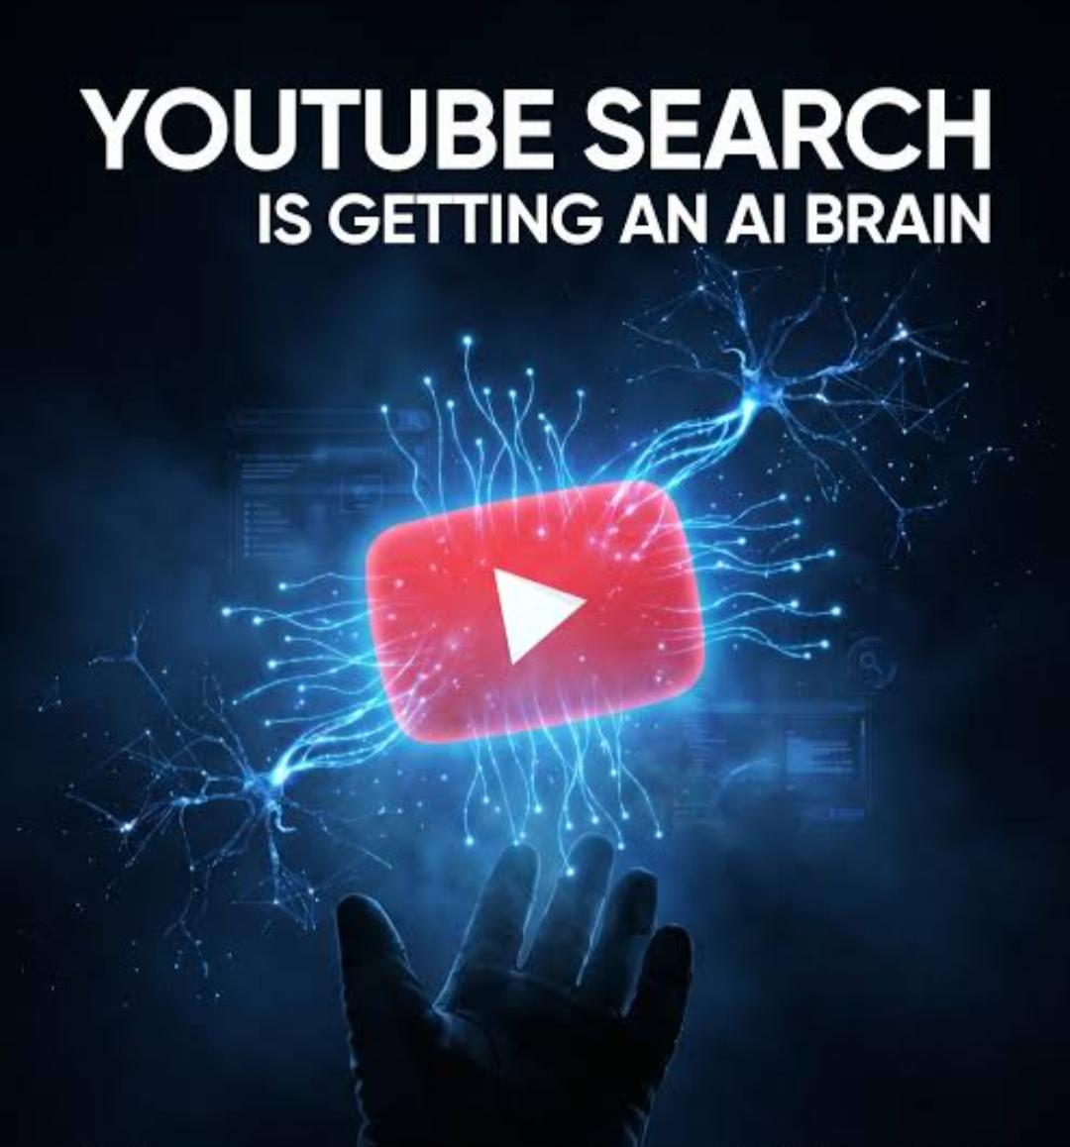
AI in YouTube
How AI is used in YouTube: Recommends videos based on watch history Suggests related content Understands user interests Improves user experience
Example: If a user watches coding videos regularly, YouTube AI recommends more programming content.

Slide 4
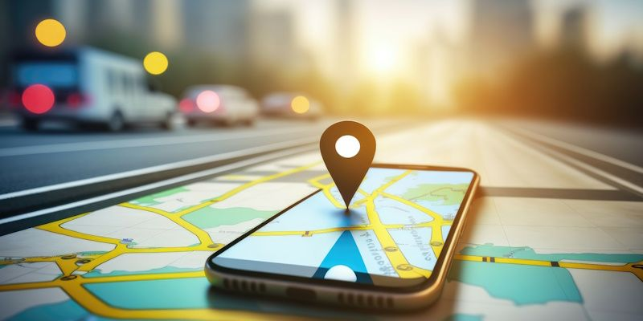
AI in Google Maps
How AI is used in Google Maps: Predicts traffic conditions Finds fastest route Gives live navigation Suggests nearby places
Example: Google Maps analyzes traffic data and suggests shorter routes to save time.

Slide 5
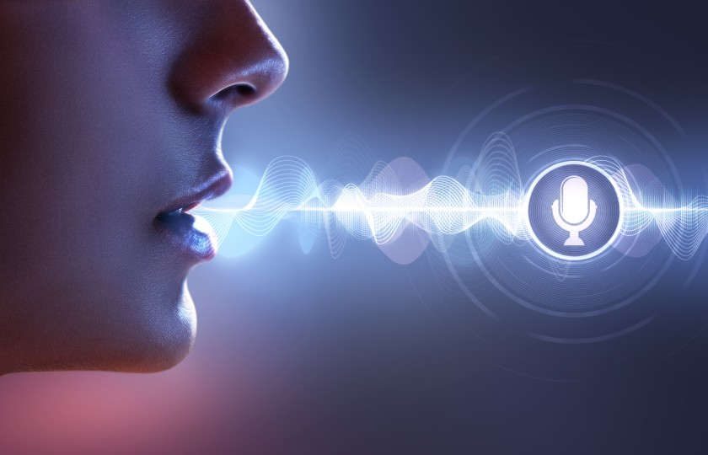
Voice Assistants( Google Assistant)
How AI is used in Voice Assistants: Understands voice commands Converts speech into text Answers questions Performs tasks like setting alarms and searching information Example: Google Assistant can answer questions and open applications using voice commands.

Slide 6
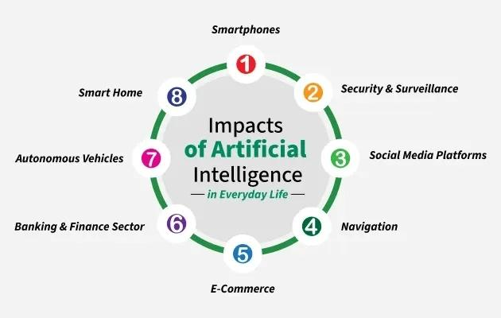
Conclusion
Artificial Intelligence has become an important part of daily life. It helps users save time, improve productivity, and make smart decisions through modern applications and devices.

Slide 7


